Slide 1
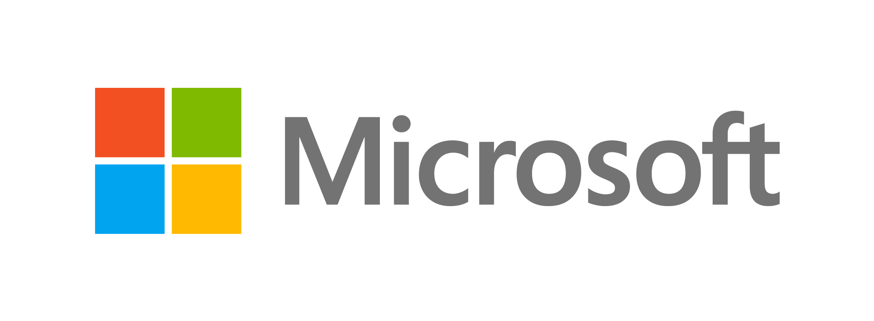
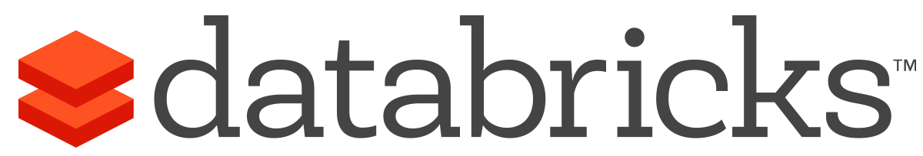
Take a deep dive into Azure Databricks, the new Spark offering
Participate in a hands-on lab customized for your use case!
Join us for a Cloud Immersion Experience, Azure Databricks and Spark. The session will focus on Financial Service use cases and will be delivered by Microsoft Cloud Solution Experts. This event is not to be missed! Attend this hands-on workshop to:
Get an overview of the Azure Databricks solution and the key differentiators in the market.
Learn about security, RBAC, notebook experience, administration, comparison to other offerings, use cases, and case studies.
Participate in a hands-on lab where you'll load data, connect to Azure Blob Storage, see Machine Learning in Azure Databricks in action, and much more.
+
NOTE: Workshop content requires a 300-level of architectural expertise of infrastructure and solutions design in this domain (even if on another platform). Attendees should be familiar with Spark and at least one programming language (Python/Scala/SQL).

